Slide 1


AI Agronomist
Generative AI for Sustainable Agriculture
1MS24MC045
Krishna Harish
Under the Guidance of
Komala R
Associate Professor
Dept. of MCA, RIT

Slide 2
Agenda
•
Introduction
•
Functional Requirement Specifications (FRS)
•
Problem Statement
•
Non-Functional Requirement Specifications (NFRS)
•
Motivation
•
Plan for Future Work
•
Literature Review
•
References
•
Objectives

Slide 3

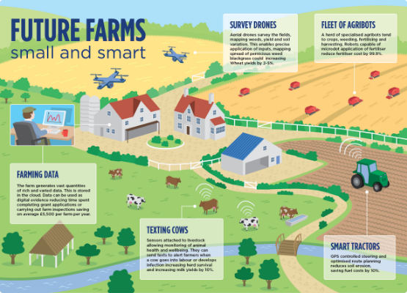
Introduction
Brief Introduction to the Problem Domain:
•
Intersection of Agritech & AI: Leveraging Generative AI to bridge the critical information gap for farmers.
•
Hyper-Localized Insights: Moving beyond generic advice to context-aware data regarding weather, soil, and crops.
Real-World Relevance:
•
Democratizing Knowledge: Making expert agronomy accessible to smallholder farmers.
•
Climate Resilience: Adapting to changing patterns via data-driven decisions.

Slide 4

Problem Statement
Smallholder farmers face significant barriers in accessing accurate advice due to:
1. Generic AI Hallucinations
2. Language Barriers
Standard LLMs lack regional context and often "invent" facts, leading to unreliable and potentially harmful advice.
Most digital tools are English-first, while rural farmers predominantly speak diverse local dialects.
3. Data Latency
4. Hardware Constraints
Models rely on old training data, missing crucial live updates like sudden weather changes or government schemes.
Existing solutions require high-end hardware, whereas farmers typically use low-end Android devices with poor connectivity.

Slide 5
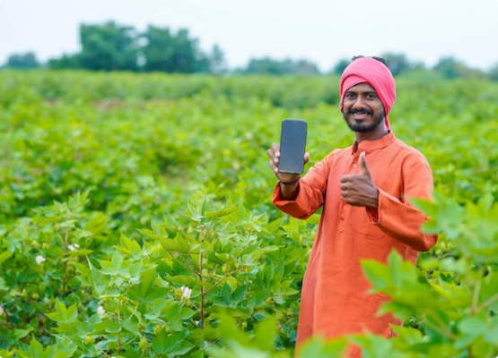
Motivation
Why this project?
•
To bridge the Digital Divide, ensuring no farmer is left behind due to literacy barriers.
•
To address the urgent need for Climate-Resilient farming practices.
Industry Relevance:
•
Aligns with "Digital Public Infrastructure" initiatives (e.g., Digital India).
•
Economic Impact: Potential 15% reduction in input costs.
•
Productivity: Target 20% yield increase via precision timing.

Slide 6

Literature Review
Author(s) / Year | Aim & Methodology | Outcome / Gap Identified
Balaguer et al. (2024) | RAG vs Fine-tuning pipelines in Agriculture | RAG is superior for dynamic data (weather). Gap: Real-time accuracy on edge.
Singh et al. (2024) | Farmer.Chat: Scaling AI-Powered Services | Success in chat interfaces. Gap: Lack of robust dialect voice support.
Narisetti & Bodapati (2024) | Deep Learning for Leaf Disease Prediction | High accuracy CNNs. Gap: Optimization for offline/low-resource devices.

Slide 7
Objectives
•
Develop a Context-Aware Voice Assistant: Hands-free, multilingual interface supporting local dialects (>90% intent recognition).
•
Implement RAG Pipeline: Fetch verified, real-time facts (Weather, Soil, Schemes) to eliminate hallucinations.
•
Deploy Edge AI Diagnostics: Offline-capable Computer Vision (CNN) to diagnose crop diseases directly on mobile devices.
•
Optimize for Low-Resource Hardware: Mobile-first strategy (Flutter, TFLite) for low-end Android phones.

Slide 8

Functional Requirement Specifications
FR No | Feature Name | Description | Priority
FR-001 | Multilingual Voice | Input/Output in native dialects (Bhashini/Google). | High
FR-002 | Visual Diagnosis | Capture image & detect disease (Rust, Blight). | High
FR-003 | Advisory Engine | Synthesize weather + soil data for schedules. | High
FR-004 | Offline Mode | Core diagnostics must work without internet. | Medium

Slide 9
Non-Functional Requirement Specifications
NFR No | Type | Description
NFR-001 | Usability | "Voice-First" design for low-literacy users.
NFR-002 | Performance | Low latency on edge devices; Optimized RAG queries.
NFR-003 | Reliability | >88% accuracy in variable field lighting conditions.
NFR-004 | Scalability | Backend supports concurrent users via Vector DB.

Slide 10



Plan for Future Work
Phase I
Phase II
Phase III
Phase IV
Concept, Design & Feasibility Analysis
Implementation
Testing
Deployment
Flutter Frontend & FastAPI Backend Integration
Dialect accuracy checks & User feedback loops
Offline TFLite models & Field Pilots
(Completed)

Slide 11
References
•
Balaguer, A., et al. (2024). 'RAG vs Fine-tuning: Pipelines in Agriculture.' arXiv Preprint.
•
Singh, N., et al. (2024). 'Farmer.Chat: Scaling AI-Powered Agricultural Services.' IFPRI.
•
Pinninti, S. K., & Kumar, G. S. (2025). 'AgriVoice: Multilingual Voice & Text Assistant.' JETIR.
•
Narisetti, N., & Bodapati, R. (2024). 'Deep Learning-Based Real-Time Plant Leaf Disease Prediction.' IJIRT.
•
Chakravorty, C., et al. (2025). Augmented Reality/Virtual Reality for Immersive Collaboration. SN COMPUT. SCI.

Slide 12



Thank You
Questions?

Slide 13




Image Sources
https://upload.wikimedia.org/wikipedia/en/5/5a/Ramaiah_Institutions_Logo.png
Source: en.wikipedia.org
https://blogs.adb.org/sites/blogs/files/file-attachments/MfUMZClDyHeukvt1MQJBDiWbJX52cYlMeoaGgI7ZM4M.jpg
Source: blogs.adb.org
https://img.freepik.com/premium-photo/indian-farmer-showing-smartphone-cotton-agriculture-field_75648-12479.jpg
Source: www.freepik.com
https://stg-uploads.slidenest.com/template_3314/templateColor_3201/previewImages/planning-a-sustainable-garden-powerpoint-google-slides-keynote-presentation-template-25.jpeg
Source: slidenest.com

